Slide 1
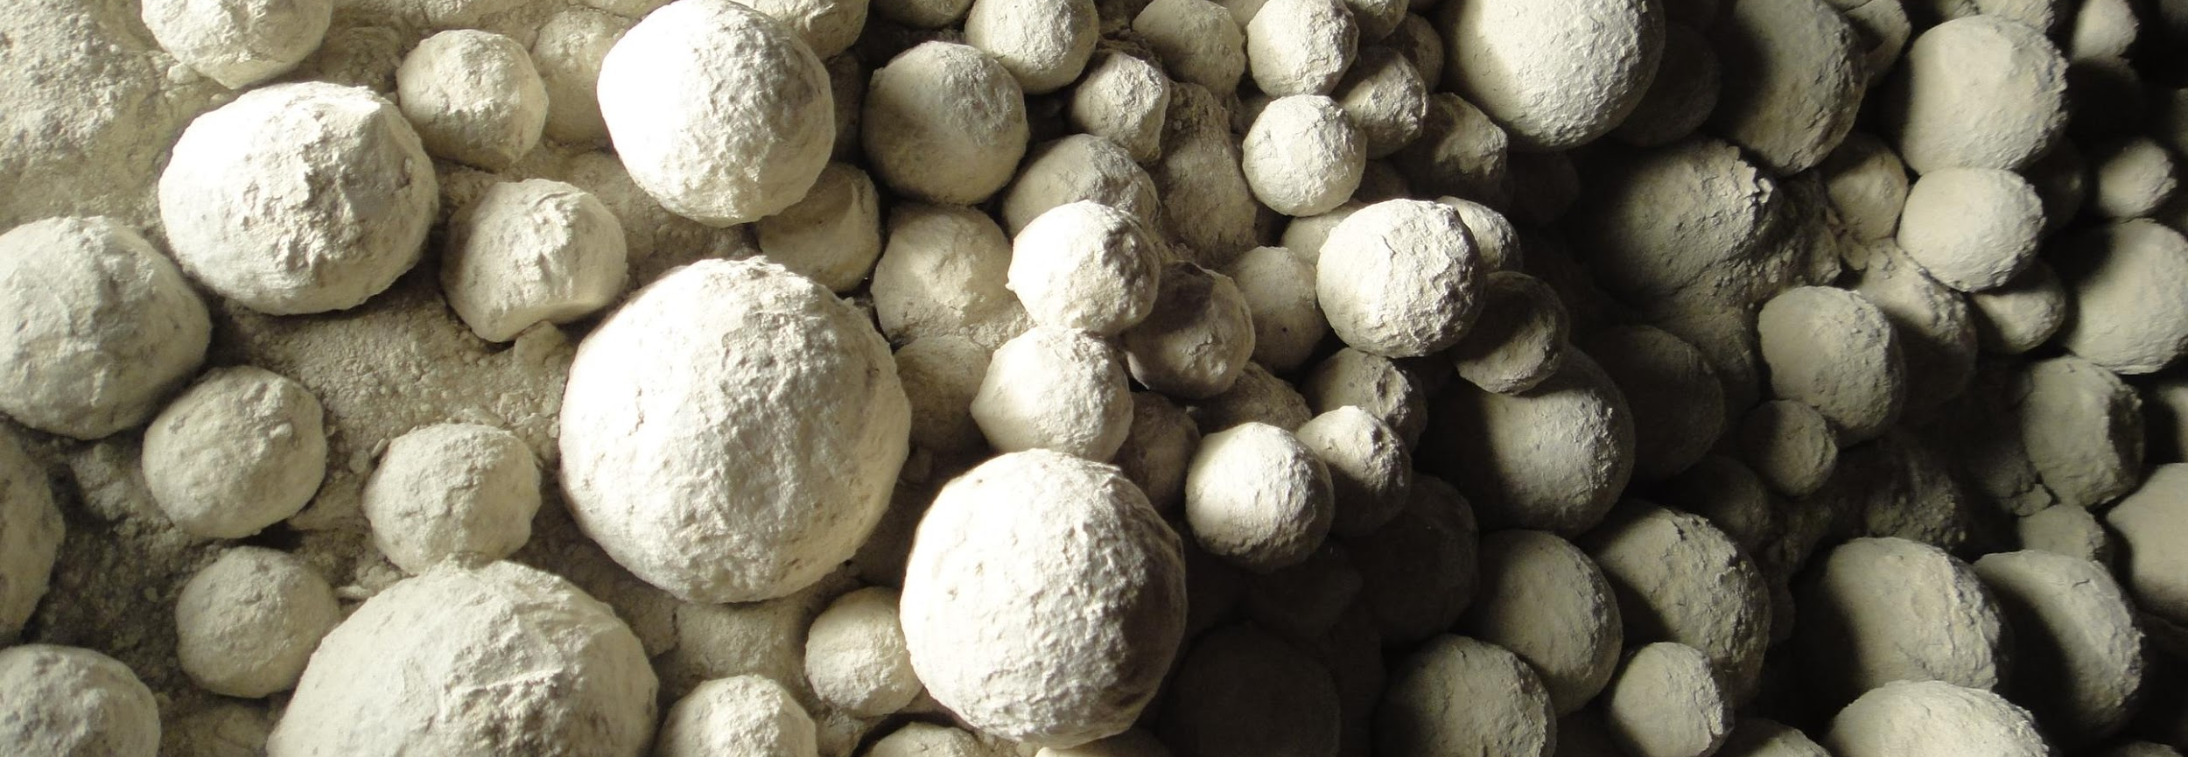
Case Study: Heat Balance
Drying and Cooling in Ball Mills and Separators

Slide 2
Content
Objectives
Problem description
Solution
Conclusion

Slide 3
Content
Objectives
Problem description
Solution
Conclusion

Slide 4
Objectives
Think about different possibilities to improve drying (or cooling) in an existing mill system
Recognize in a practical example the process limits regarding drying or cooling
Become familiar with the Holcim heat balance tool and learn, how to evaluate a heat balance on a ball mill system

Slide 5
Content
Objectives
Problem description
Solution
Conclusion

Slide 6
Description of Situation
In the Nowhere plant the product portfolio consists at present of a
OPC (3000 cm²/g / BDP 140 t/h) with 6 % of gypsum (moisture: 6 % wet basis) and 94 % of clinker
Limestone cement (3700 cm²/g / BDP 140 t/h) with 10 % of limestone (moisture: 6 % wet basis), with 6 % of gypsum (moisture: 6 % wet basis) and 84 % of clinker
Now, marketing wants to introduce a new slag cement type with 40 % of slag.
Slag cement (4700 cm²/g / BDP_{expected} 110 t/h) with 40 % of slag (moisture: 8 % wet basis) and with 6 % of gypsum (moisture: 6 % wet basis) and 54 % of clinker

Slide 7
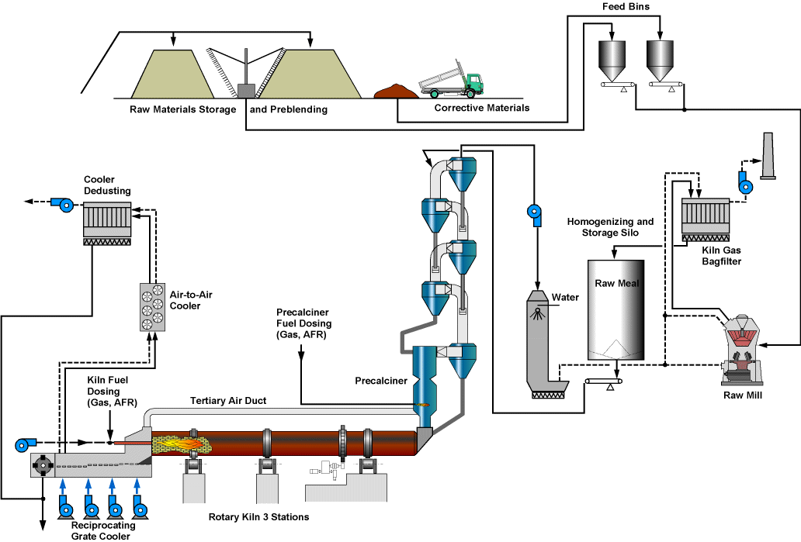
Kiln and Raw Mill Line Nowhere Plant

Slide 8
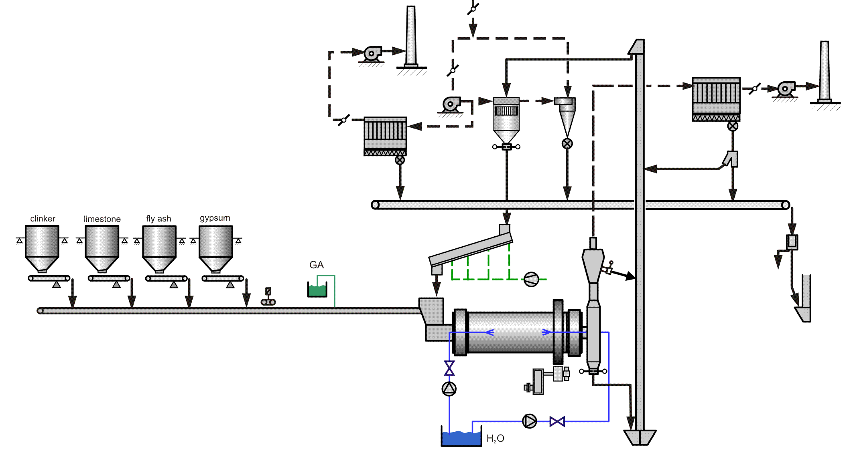
Cement Mill Nowhere Plant
clinker
limestone
gypsum
slag

Slide 9
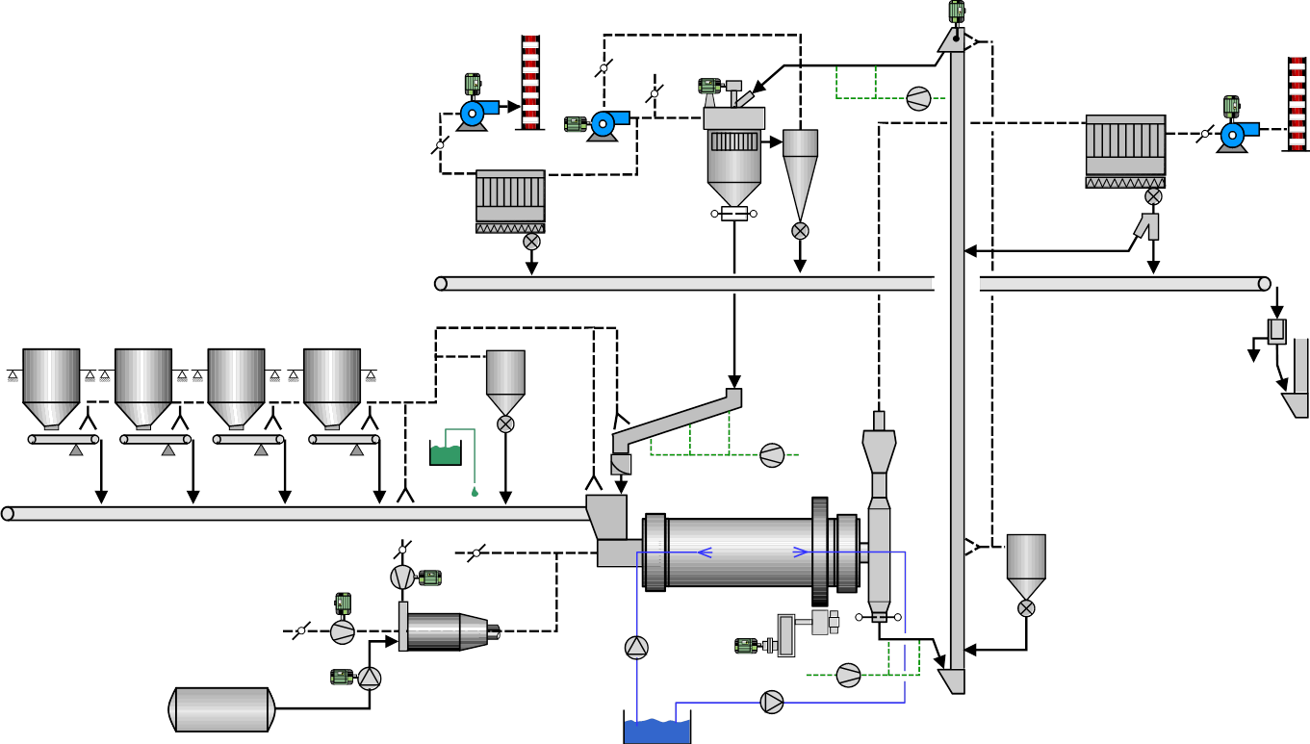
Cement Mill circuit details
Mill type | End Discharge Mill (EDM)
Installed power mill drive | 4000 kW
External heat source (e.g. HGG, kiln gas) | Not available
Ball mill filling degree | 1st Chamber: 30 % / 2nd Chamber: 30 %
Transmission type | Girth gear drive
Separator type | High Efficiency Separator with cyclone air system
Design capacity of bucket elevator | 570 t/h
Storage of clinker, gypsum and limestone | In storage hall – feed to mill with overhead crane
Storage of slag | Open storage now, but storage hall under construction
Feed rate limitations of mill feeding system | No limitations
Allowable average feed temperature of dosing and transport systems | max. 130 °C
Water injection system into mill | Installed, but pump broken

Slide 10
Task Description
Production of the Slag Cement:
Review the already completed heat balance program for the limestone cement scenario. Check, if the production of this slag cement with 40 % slag is feasible or not with the current mill system, only by optimizing the operational process parameters (e.g. mill and separator ventilation, mill feed temperature, …). No additional external heat source may be used.
If not, what is the maximum percentage of slag, which can be added?

Slide 11
Hints for the Task (Production of Slag Cement)
Check the following points, which may limit the drying potential for the production of this Slag Cement, if there is optimization potential or not (get detailed process data also from the EXCEL Heat Balance!!)
Excess moisture in the mill fresh feed
Low clinker temperature
Low clinker factor
High mill ventilation
Low circulating load
High fresh air rate in the separator
Low power consumption in the mill first grinding chamber

Slide 12
Hints for the Task (Production Capacity Increase)
The following, already existing equipment of the ball mill circuit will be no bottleneck for the 100 % increased production capacity
High Efficiency Separator
Bucket elevator from ball mill to HES
Cement transports from mill to silo
Silo capacity
Space in the cement mill building

